Slide 1
Module 10c
Spotlight 6
L.A. Nuzhnenko

Slide 2
Find the following word combinations in Jane’s email and translate them. Answer the questions.
Errand
 | Сказочный
Head back home
Performance
 | С нетерпением жду…
What are you looking forward to?
Do you have any errands for tomorrow?
What was the most fabulous weekend for you?
Ex.2, page 100

Slide 3
Project. You are going to spend a weekend in Vladimir – a city with amazing cathedrals and churches which can tell the history of Russia. Look at the pictures and make a tour for your family. Say what you are going to visit. Use the Internet (http://www.vladimir-city.ru) to find out any hotels where you can stay, cafés you can have lunch at, museums/sights to visit. Make a plan for your fabulous weekend in Vladimir.

Slide 4
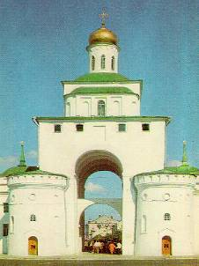
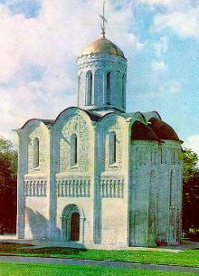
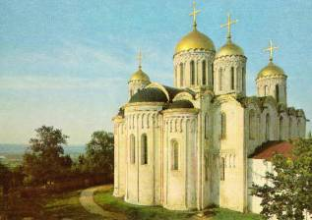
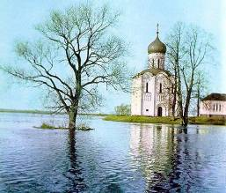
Zolotye Vorota (The Golden Gate)
St Demetrius Cathedral
Pokrova na Nerli
Assumption Church

Slide 5
Write a postcard to your friend from Vladimir.
Share you feelings and impressions.
__________________
__________________________________________
____________________________________________________________________________________________________________________________________________________________________________
_____________________________________

