Slide 1
Module 8d English in Use
Spotlight 6
L.A.Nuzhnenko

Slide 2
https://www.youtube.com/watch?v=7otAJa3jui8
Row, row, row your boat gently down the stream
Merrily, merrily, merrily, merrily,
Life is but a dream.

Slide 3
Listen and read the text about The Empire State Building and choose the correct answer.
The Empire State Building
is the tallest building in the world.
is the tallest building in New York.
It took….. to complete.
410 days
420 days
At the Empire State Building most visitors go straight to the…
Laboratory.
Observatory.
The building can be white, green, blue, purple, red and orange…
1.depending on the day of the week.
2.depending on the occasion.

Slide 4
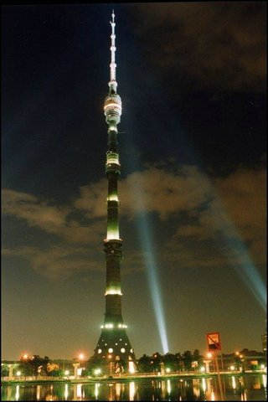
Read about Ostankino Tower
and make an outline of the text:
When: Who:
Height: What:
The total height of the Ostankino Tower (designed by Nikolai Nikitin) is 540 meters. Construction began in 1963 and was completed in 1967. It is the highest freestanding building in Europe and Asia. At one time, the Ostankino TV Tower was the highest construction in the world. This grandiose construction has 45 levels, tens of ring decks and balconies. It has also got a restaurant called “The seventh sky” with a glass revolving floor. The restaurant opens a fantastic view over Moscow.

Slide 5
Translate the sentences into Russian.
Listen and act out.
I’d like to book some theatre tickets, please!
How would you like to pay?
Which play would you like to see?
Can I pay by credit card?
Give me the number and the expiry date.
Enjoy the show!

Slide 6
Ex.4, page 82. Listen, tick and repeat.
Group the words according to the sound [au] or [əu]:
Cow, bone, road, round, row, coal, house, toast, how, low, now
[au] | [əu]

Slide 7
Read out the sentences as fast and correct as you can.
Now, now! – Ну, ну! Успокойся!
It’s bound to be found out. – Это непременно обнаружится.
Out of the house to the grounds! – Ну-ка, все на свежий воздух!
It’s a cold coal to blow at. – Это безнадежное дело.
Go slow. – Не спеши. (Будь осмотрительным.)

Slide 8
Put the adjectives in the correct form.
My sister is the ________ (good) pupil in her class.
It is a very ________ (funny) English book.
This baby is the __________ (smart) baby in the world.
My bike is __________ (small) than your bike.
Tigers are _________ (big) than dogs.
The dog is a _________ (clever) pet.
I think giraffes are the ________________ (beautiful) animals.
Mary is as ________ (old) as Henry.
The water in the ocean is _________ (cold) than in this lake.
My book is ___________________ (interesting) than yours.
I think he is the ____________ (happy) boy here.
I’m sure you can be __________ (happy) than you’re feeling now.

